Slide 1
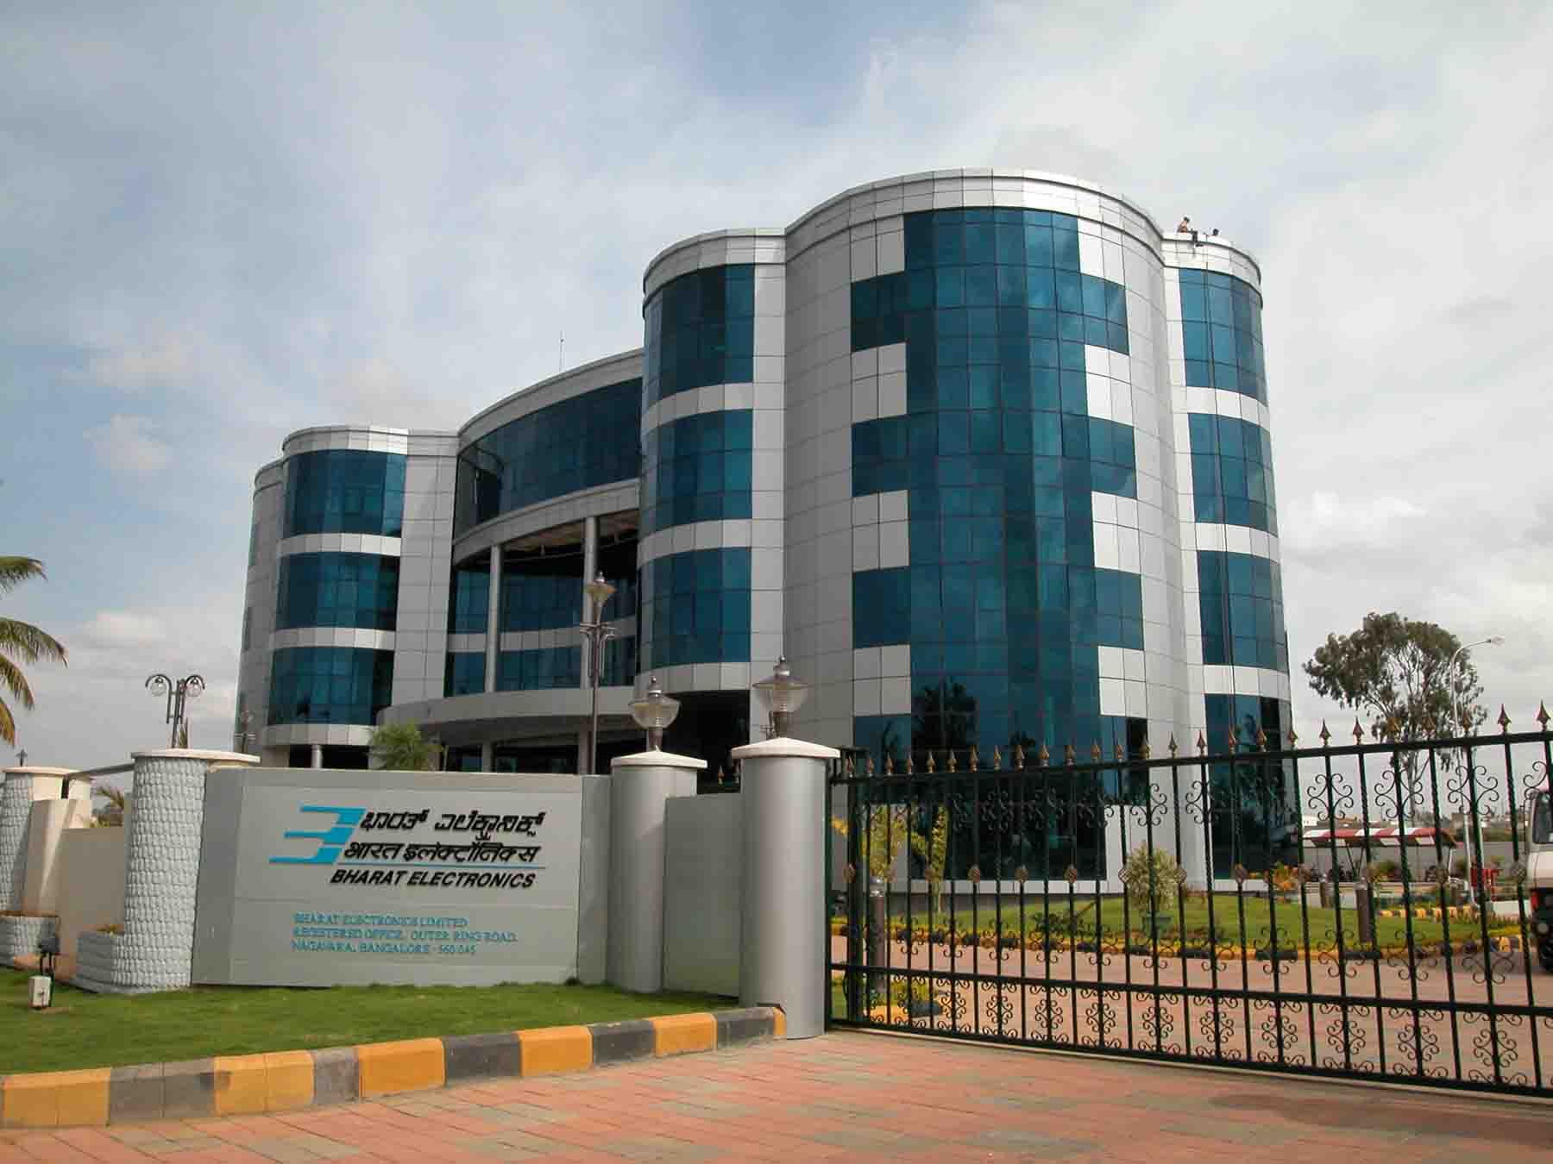
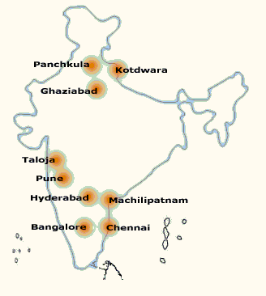
Bharat Electronics
www.bel-india.in

Slide 2
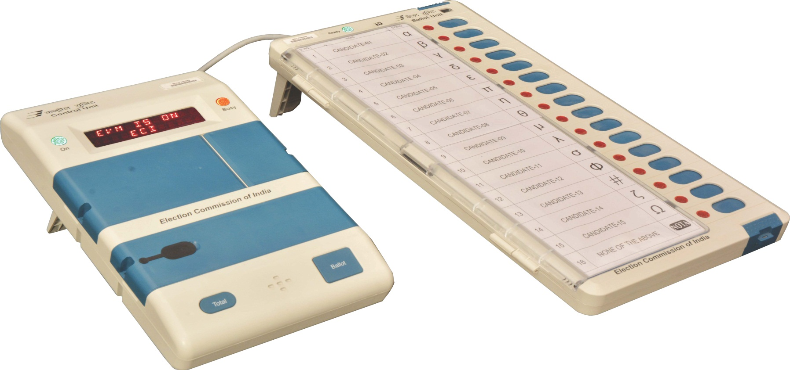
EVM
First Level Checking of
Electronic Voting Machine (EVM)

Slide 3
EVM
FLC of EVM

Slide 4
FLC PROCEDURE
EVM – FLC PROCEDURE
VISUAL INSPECTION
(i) Open Carrying cases of Control Unit (CU) and Ballot Unit (BU)
and take out the units.
(ii) Remove all tags, pink paper seal, FLC stickers, wax seals and Ballot papers of previous election.
b) (i) Physically check all buttons, toggle switch, connectors, and
doors, sealing provisions, display and plastic body of CU for
damage / breakage.
(ii) Replace the broken items with good items wherever possible
and discard others.
c) (i) Similarly, check connecting cable, connector, latches, and flaps
and slide Switch and plastic body of BU for damage / breakage.

Slide 5
1. VISUAL INSPECTION (ii) Replace the broken items with good items wherever possible and discard others. d) (i) Open cabinet of CU and carryout visual inspection of PCB, hidden components if any, unauthorized rework if any. (ii) Any discrepancy should be brought to the notice of DEO or his representative immediately. e) (i) Similarly open cabinet of BU and carry out visual inspection of plastic parts and other and PCB for any damage, rework etc. and replace the damaged one if feasible. (ii) Presence of any rework or hidden components to be brought to the notice of DEO or his representative immediately. f) Check the number plate and number sticker pasted on the back of CU and BU for any mismatch.
EVM – FLC PROCEDURE

Slide 6
1. VISUAL INSPECTION g) Reject units that cannot be rectified as per b, c and d above and keep aside. h) In case of wrong Date and Time, reject the Control Unit . i) Record the serial numbers and defects of rejected units. j) If VVPAT is used, perform physical inspection of VVPAT and clear previous symbols and load dummy names and symbols (A, B… and Alpha, Beta etc.). k) During visual Inspection, if any M1 EVM or State Election Commission EVM is found mixed with the M2 or M3 EVMs, they should be kept separately and matter reported to the FLC in-charge.
EVM – FLC PROCEDURE

Slide 7
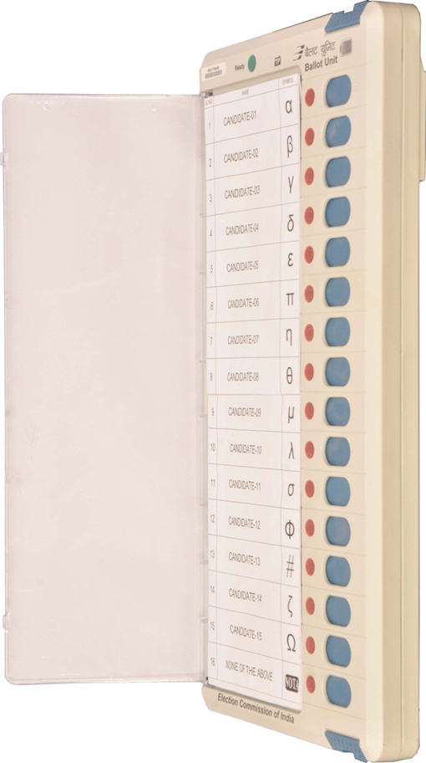
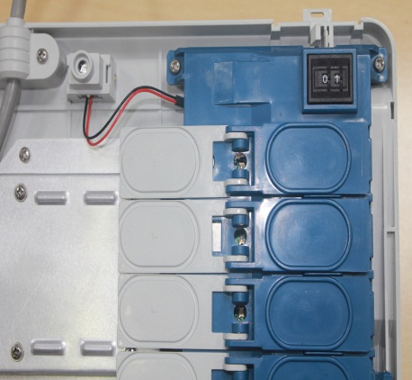
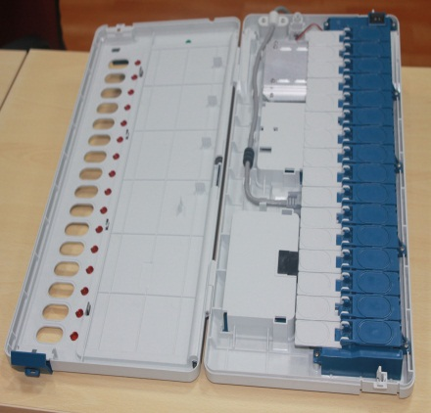
EVM - Ballot Paper Insertion
2. FUNCTIONALITY CHECK
Set Thumb Wheel Position of BU to 1
Unmask all 16 Candidate buttons in BU
Insert Dummy Ballot Paper in Ballot Sheet Compartment

Slide 8
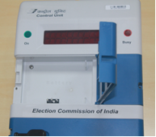
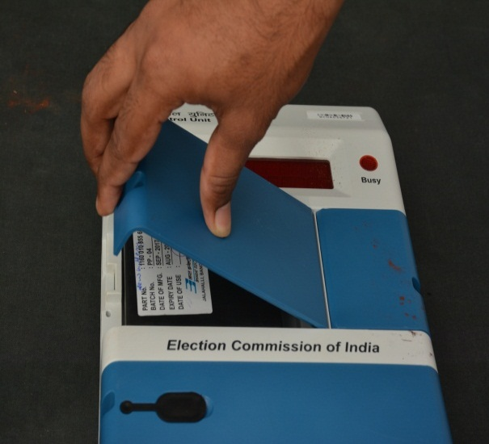
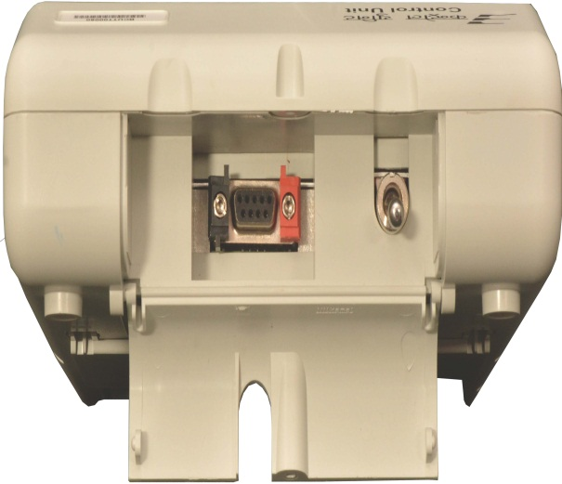
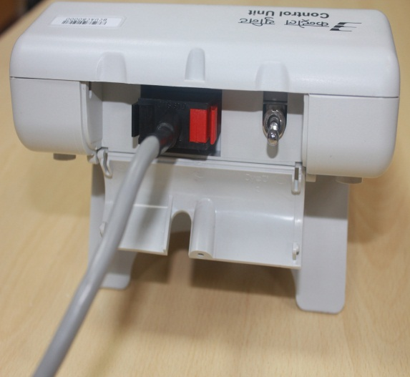
EVM - CONNECTION
Installation of Power Pack & Cable Connections
Open Battery Compartment. Insert new Power pack and fix in Control Unit by plugging in
Open bottom compartment and CONNECT Ballot Unit cable connector by pressing the hood of the connector
If VVPAT is to be used then connect VVPAT also with CU, BU as per connection procedure

Slide 9
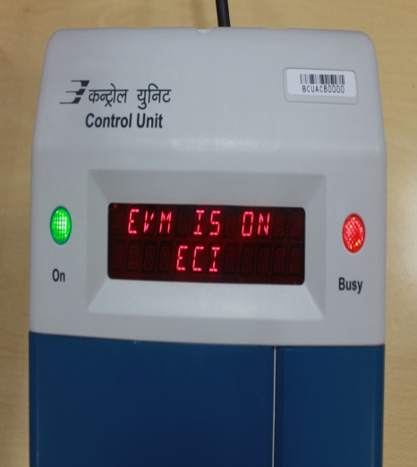
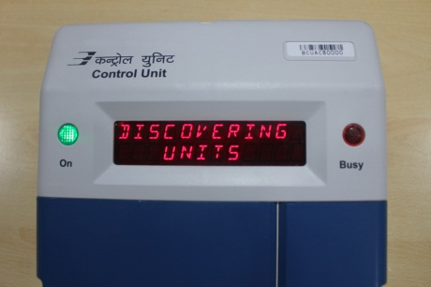
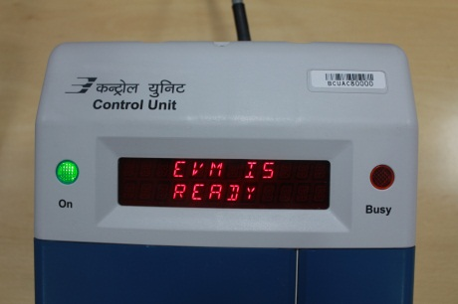
EVM – Power ON
Power ON Display Sequence
Display Sequence
EVM IS ON
DATE and TIME
SL NO of the Control Unit
NO OF CANDIDATES
BATTERY STATUS
Discovering Units
Discovered BUXX(where XX denotes number of BU connected to CU)
BU01 GN1Testing
BU01 GN1 OK
EVM IS READY
Note: Reject the EVM in case
of any defect.

Slide 10
EVM – Candidates Setting
When button is pressed, if the digit display panel shows the words
, It signifies that the data relating to some previous operation is in the EVM.
Cand. Set
INVALID
Press the button and wait till is displayed
Close
POLL CLOSED
Thereafter, press button and wait till is displayed
Result
END
Thereafter, press button and wait till is displayed
Clear
END
Then press button and flashes with Beep
Cand. set
SET CANDIDATE
Now press the last candidate’s button on the Ballot Unit

Slide 11
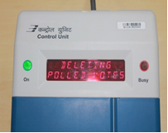
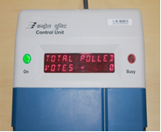
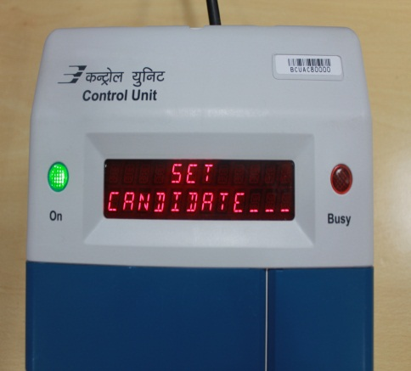
EVM – Polling Sequence
Clearing of previous votes :
Open the outer door of Result compartment and then open the inner door. Press CLEAR button to delete any votes stored in CU.
Candidate Set Operation :
Press CANDIDATE SET button for setting candidates. Observe “SET CANDIDATE – “display in CU. Press 16th button in BU to set the number of Candidates to 16.
If VVPAT is to be used then dummy symbols should also be loaded in VVPAT.

Slide 12
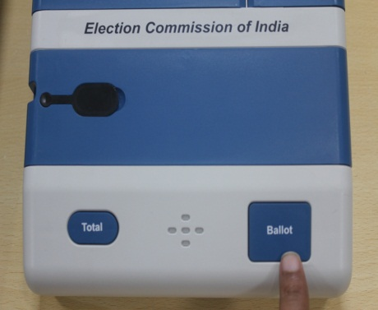
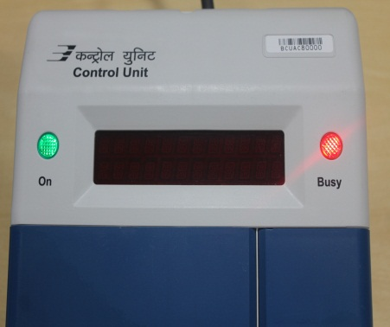
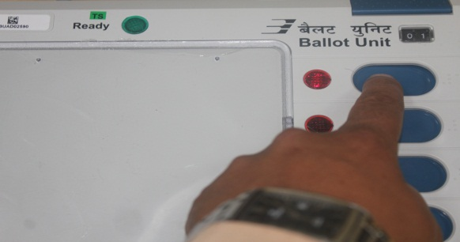
EVM – Polling Sequence
Ballot Operation :
Press BALLOT button in CU. BUSY LED in CU shall glow RED and READY LED in BU shall glow GREEN.
Press first candidate button in BU.
Repeat the process of Pressing Ballot button in CU & cast vote till 16th candidate button in BU.

Slide 13
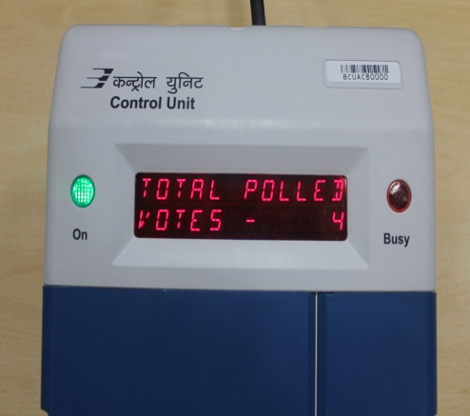
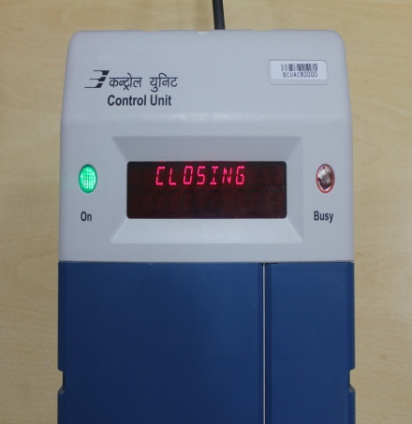
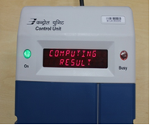
EVM – Polling Sequence
Total Operation:
Press TOTAL. Check number of candidates 16 and total votes 16 in CU display.
Close Operation:
Press CLOSE button. Observe CU displays “POLL CLOSED”.
Result Operation :
Press RESULT button and observe the vote cast against each candidate.
Clear Operation:
Press CLEAR button and wait till CU displays “0” votes for all the candidates. Press TOTAL to confirm Total Votes 0.

Slide 14
EVM – Operation Sequence
Close
Result
Clear
Cand. set
Ballot

Slide 15
EVM – Polling Sequence
MOCK POLL
Additionally, mock-poll in 1% of EVMs of 1200 votes, in 2% of EVMs of 1000 votes and in 2% of EVMs of 500 votes ( or as per latest information given by Election Commission of India) shall be done .
Mock-poll shall be done with VVPAT and votes cast in EVM must be tallied with VVPAT Ballot Slips.
It shall be ensured that during the mock poll, testing or demonstration of EVM or VVPAT, dummy Ballot Paper with dummy names and dummy symbols are used.

Slide 16
EVM – Polling Sequence
SEALING OF CONTROL UNIT
In order to ensure that the Control Unit of the EVM cannot be opened after First Level Checking of the EVMs, the Control Unit shall be sealed with the ‘Pink Paper Seal’ .
The Pink Paper Seal shall be affixed on the portion between the Candidate Set Section and the Result Section of the Control Unit.
After fixing the Pink Paper Seal, the Engineer of the Manufacturer shall put his signature on the Pink Paper Seal.

Slide 17
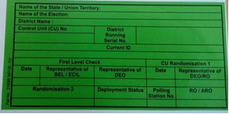
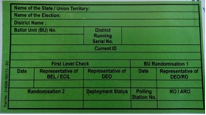
EVM – Polling Sequence
DOCUMENTATION
Paste the FLC-OK (Green) sticker on back side of FLC-OK CU and BU. Record the Serial Number of Control Unit and Ballot Unit and affix signature on FLC sticker.
Note down total numbers of CUs and BUs that are accepted after FLC in the prescribed format.
FLC in-charge shall also sign all FLC ‘OK’ and FLC ‘Reject’ stickers.
Consolidate Serial numbers of defective units and defects observed in the prescribed format. Submit a copy of the same to FLC In-charge.

Slide 18
DIFFERENCE IN FLC OF EVM M2 AND M3
EVM – DIFFERENCE
After Mock poll of additional 5% of EVM, to tally the result of CU, print out has to be taken from Printer in case of M2 EVM, but in M3 EVM, the VVPAT Ballot Slips are to be counted.
In case of Wrong/Mismatch Date and Time, it has to be corrected with Set Date and Time Jig in case of M2 EVM while it has to kept aside in case of M3 EVM.

Slide 19
EVM – CHECKLIST
CHECKLIST FOR WORKS TO BE DONE DURING FLC of EVM M3
SL. NO. | PROCEDURE | YES/NO | REMARKS IF ANY
1. | Remove Old seals, Address tags, pink paper seal & Ballot paper.
2. | Inspect EVM by checking plastic parts, connectors, doors, latches etc.
3. | Open Plastic Cabinet of CU & BU, for verification of Components and Close the plastic cabinet after verification. Put Tamper sticker on Screws.
4. | Make connection of CU & BU and switch ON CU to carry out self-diagnostic test. Check LED Display, Buzzer & all buttons pass the Test.
5. | In case Date/Time displayed in CU is not correct, reject CU.
6. | Cast one vote against each Candidate (total 16 votes) and tally the results. Clear votes after Polling Test.
7. | Remove the Battery pack from CU.
8. | Seal CU with Pink Paper Seal and maintain records of CU Serial number with corresponding Pink Paper Seal Number.
9. | Paste Green FLC sticker for passed / OK CU & BU.
10. | Conduct Mock Poll in additional 5% EVM (as described in FLC procedure) & tally the CU results with the VVPAT Ballot Slip Count.
11. | Keep aside Defective EVMs and maintain the record in Defective EVM Report. Enter the details in EVM Checking Certificate.

Slide 20
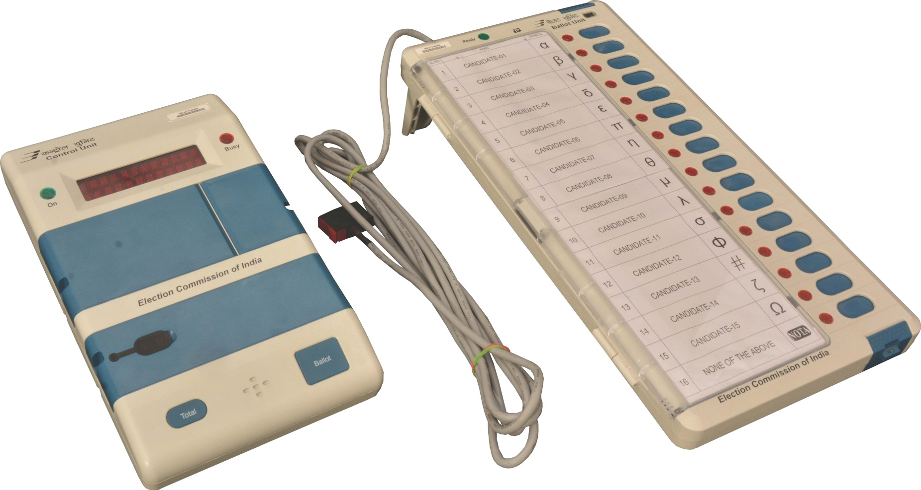
EVM
THANK YOU
www.bel-india.in

